Slide 1
Interference Control for Spectrum Sharing
Spectrum sharing in cognitive radio network

Slide 2
Cognitive Network
Primary users and secondary users coexist
Hybrid of overlay and underlay Spectrum sharing
Power control

Slide 3
Problem Formulation
Interference temperature at the sentinels
Link quality of secondary users
available transmission power of secondary users
objective function

Slide 4

Relaxed Problem
Soft admission ($X_{i}$ relaxed)
Hard decision
Refine sub-optimal solution
quick adaption methods

Slide 5
Game Based Distributed Algorithms
Game based model
Designing price (Lagrange relaxation)
Best response
Straight forward distributed algorithm

Slide 6
Overall Design
Intended movement
Smoother movement

Slide 7
Quick Adaption to Interference Margin
Interference margin
Equal weights, SINR weights, proportional scaling

Slide 8
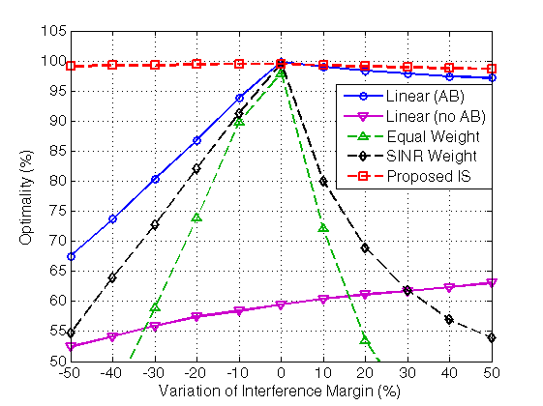
Adaptions to Margin Variation

Slide 9
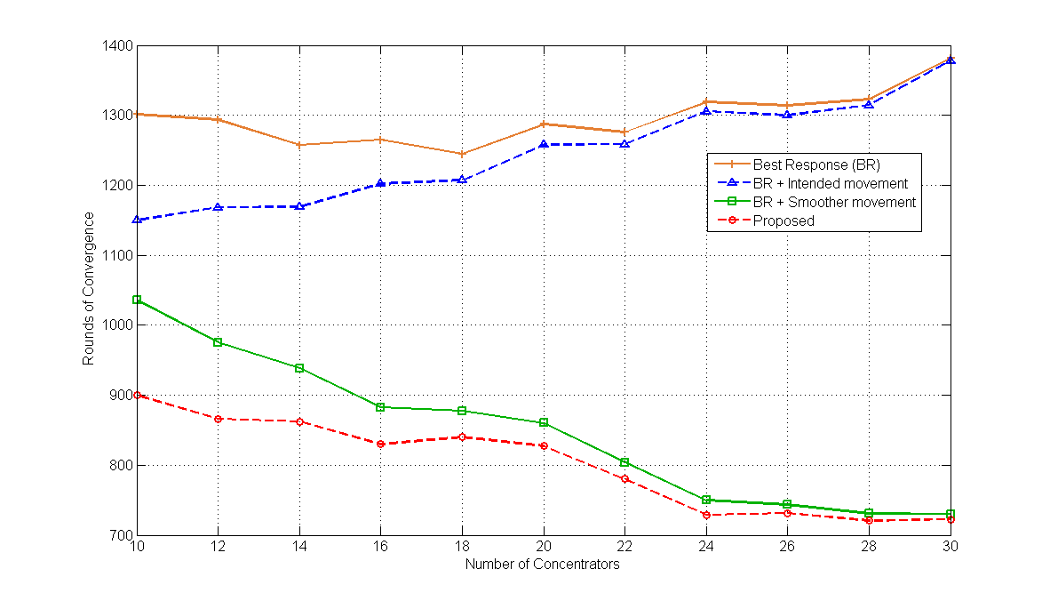
Rounds of Convergence to Number of T-pairs

Slide 10
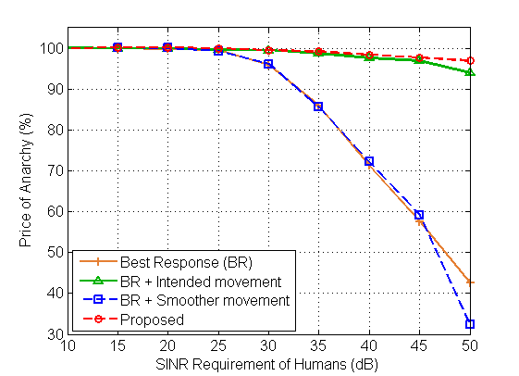
Performance to QOS of Primary Users

